Slide 1


PROGESS LOG
Edited by
Loek Ehren
Mike Schatorjé
Simone Francesconi
Herm Lecluse
Rick van Osch

Slide 2
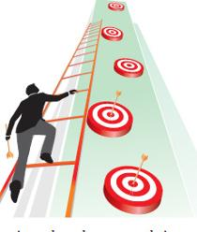
What did we want to achieve?
Finish test application
Get the information about the interview
Set up the “Raspberry pi”
Prepare the test plan

Slide 3
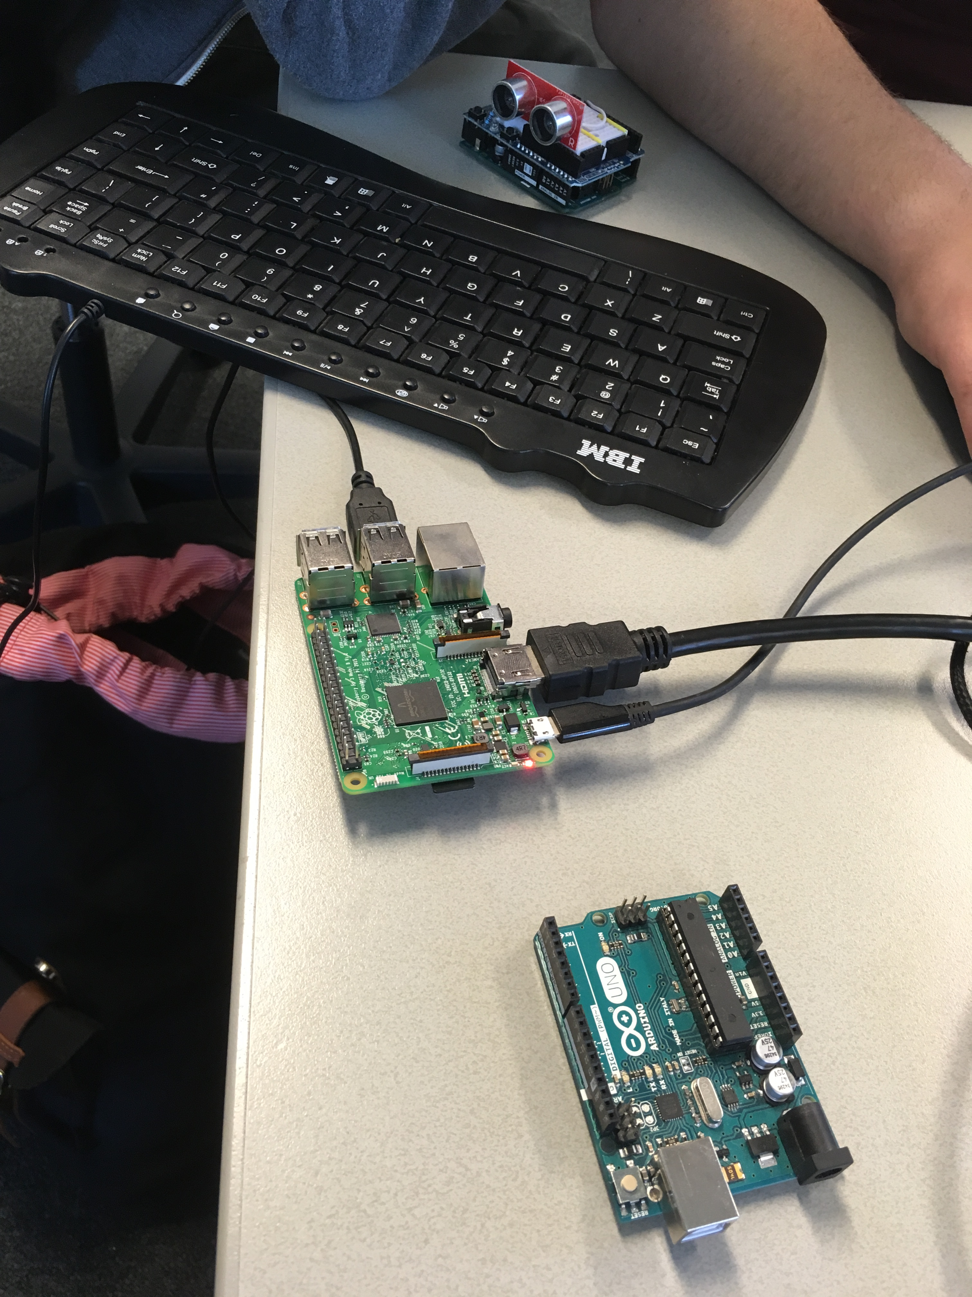
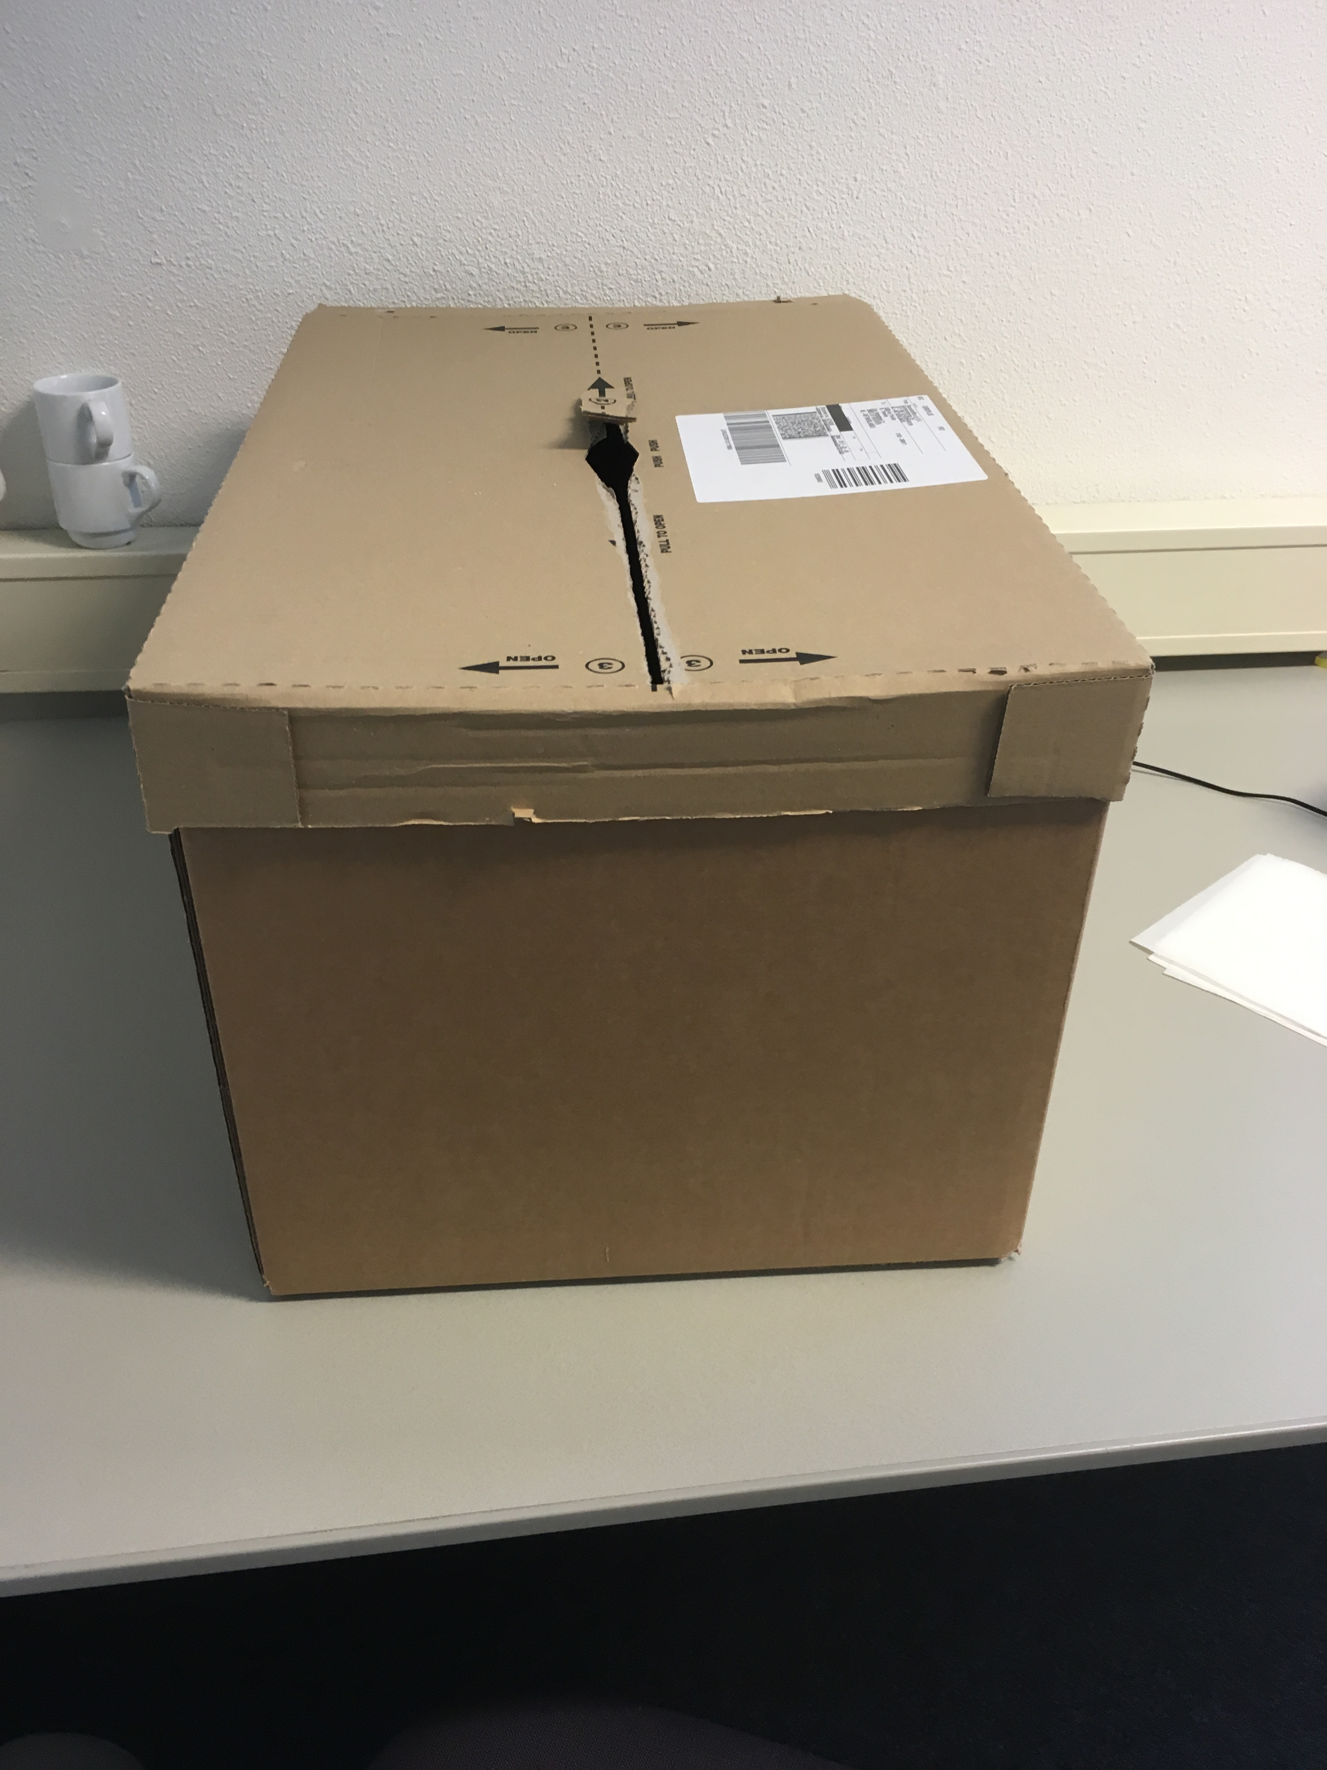
How did we do it?
Continuing in development
Testing the sensors
Testing “Raspberry pi”
Work on the audio interview

Slide 4

What were the results?
Test plan ready to use
All of the sensors work properly
Talking with experts helped us to have a clear picture of our project-work

Slide 5
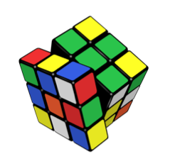
What were the problems?
Some problems with the “Raspberry pi” wi-fi connection
TheThings “Uno” is not deliverable before the end of April
The interview is not completed

Slide 6
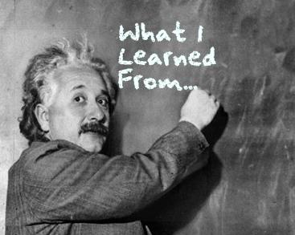
What were the lessons learned?
The interview should be processed together with the interviewed
Hard to work with the Raspberry pi without any knowledge about that
To have a clear picture of what we want to reach and how to do it is very helpful

Slide 7
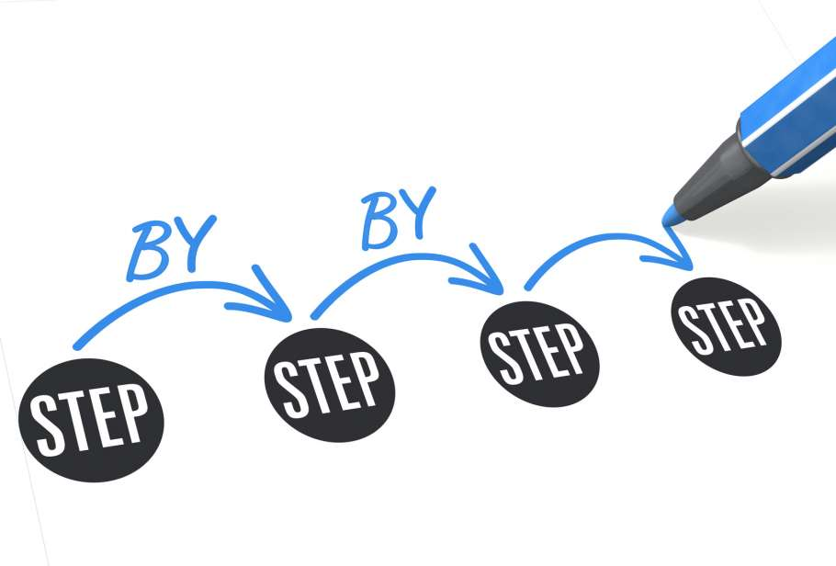
What do we want to achieve?
Manage a second appointment with the environment department
Extrapolate information from the document we got from Leo Jacob
Figure out how to solve the Raspberry pi connection
Understand how to combine the sensors in the “box”

Slide 8

How we are going to do it?
Looking what is still necessary for the testing
More researches about Raspberry pi
Make some sensor combination
Working on the document

Slide 9
Any Question?
Thanks for your attention!

